Slide 1

Education Learning Platform
Major Project - II
CS- 805
Problem Statement: Our Education Learning Platform makes learning fun and personalized with interactive lessons, games, and progress tracking. With videos, quizzes, and 24/7 access, students can learn anytime, anywhere
Project Group Number:10
Group Member Details:
Ritik Sharma 0187CS211136
Shubh Dengre 0187CS211162
Satyam Sen 0187CS211152
Rohit Chourasiya 0187CS211138
Guide Details: Prof. Amit Swami

Slide 2
Idea/Approach Details
Abstract:
The Education Learning Platform is an interactive and accessible solution designed to enhance learning experiences for students. Traditional education methods often lack personalization, engagement, and flexibility. This platform addresses these challenges by offering customized learning paths, engaging quizzes, interactive activities, and real-time progress tracking. With videos, study materials, and 24/7 accessibility, students can learn at their own pace, anytime and anywhere. This project aims to make learning more enjoyable, effective, and accessible for all learners.
Describe your idea Solution/Prototype here:
Personalized Learning Paths – Tailored lessons based on student progress and understanding.
Multi-Device Accessibility – Learn anytime, anywhere on mobile, tablet, or desktop.
Collaborative Learning – Group discussions, live classes, and peer interaction.
Diverse Learning Materials – Includes notes, practice exercises, and interactive activities.
User-Friendly Interface – Simple and easy-to-use design for all age groups.
Self-Paced Learning – Students can learn at their own speed, improving retention.
Describe your Technology stack here
Front-end Technology: HTML/ CSS, JavaScript
Back-end Technology: PHP , Django

Slide 3
Project Requirements
Interactive Learning Content – Support for videos, PDFs, quizzes, and assignments.
Functional Requirements
Non-Functional Requirements
User Authentication & Roles – Sign up, login, and role-based access (students, teachers, admins)..
Course Management – Add, update, and delete courses, lessons, and materials.
Interactive Learning Content – Support for videos, PDFs, quizzes, and assignments.
Multi-Device Support – Allow access from desktops, tablets, and mobile devices.
Live Classes & Video Conferencing Integrate real-time sessions with teachers.
Performance: The system should respond to user requests within 2 seconds.
Security: All sensitive member and financial data should be encrypted using industry-standard encryption algorithms.
SEO Optimization – Improve search engine visibility for better reach
Accessibility – Compliance with WCAG guidelines for inclusive education
Performance – Fast loading times and smooth user experience
User-Friendly Interface – Easy navigation with an intuitive UI.

Slide 4
Project Requirements
Hardware and Software requirements (Developer)
Hardware and Software requirements (Client)
For Developer Hardware requirements:
PROCESSOR : Dual-core 64-bit processor.
Minimum RAM: 4.00 GB
For Developer Software requirements :
IDE
MS Visual Studio Code (latest version)
Programming Language
HTML, CSS and JavaScript & PHP,
DataBase
Django
For Users Hardware requirements :
A compatible web browser. (recommended Google Chrome and Microsoft Edge)
For Users Software requirements :
A compatible web browser. (recommended Google Chrome and Microsoft Edge)

Slide 5
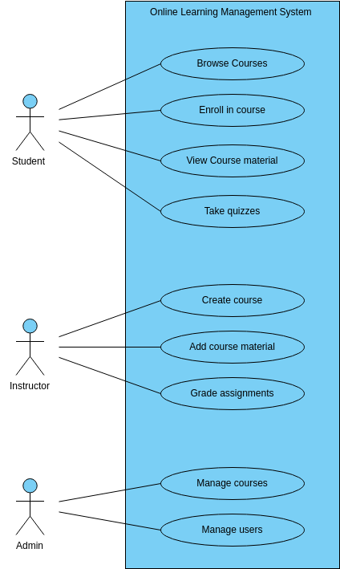
Design
Use Cases Diagram

Slide 6
Deployment Details
Describe Deployment Details here
Server Setup:
Domain Name and SSL Certificate:
Database Configuration:
File Transfer:
Server-Side Script Execution:
Web Application Firewall (WAF):
Configuration Files:
Testing:
Backup Procedures:
Monitoring Tools:
User Authentication and Access Control:
Documentation and User Guides:
Launch and Communication:
User Training:
Post-Deployment Support:
Version Control:
Feedback Mechanism:
Compliance Checks:

Slide 7
Monetary Support
Financial Requirements
Upgrades and Expansion Investment: Allocate funds for future upgrades and system expansions.
Components:
Costs for adding new features
Scalability enhancements
Maintenance and Support Allocation: Allocate funds for ongoing maintenance and user support.
Components:
Regular updates and patches
Helpdesk support
Bug fixes and troubleshooting
Software Licensing and Tools: Acquire funding for software licenses and development tools.
Components:
Operating system licenses
Database management system licenses
Development tools licenses

Slide 8
Project Screen shorts

Slide 9


